Slide 1

WEST HUNSBURY & CAMP HILL COMMUNITY - PARISH SURVEY
June 2023

Slide 2
Volumes and response rate
Number of surveys issued: 1,946 households
Number returned: 474
Percentage: 24.4%
Total no. of residents included in the responses: 1,121

Slide 3
Q1 - Please tell us the number of people at your address in each age group:
Nearly 50% of respondents are over the age of 60 (national ave = 22.4%)
13.7% are over 75
Single adult occupancy:
41-60 47%
60-75 14%
Over 75 60%
Our population appears to be ageing compared to the rest of Northampton

Slide 4
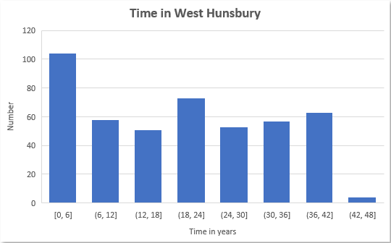
Q2 - How long have you and your family lived in West Hunsbury?
Average time living in West Hunsbury = 20 yrs
Over 100 families (21%) lived here less than 6 years

Slide 5
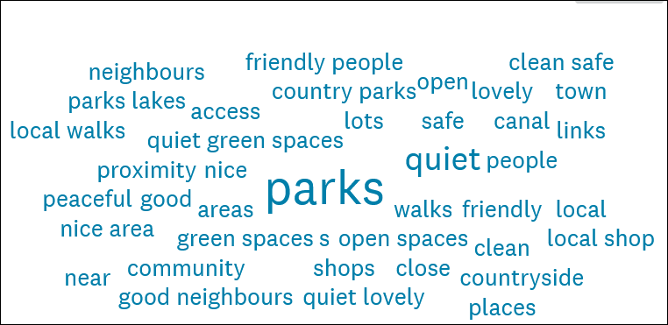
Q3 - Do you think West Hunsbury is a pleasant place to live and would you recommend it to friends and others?
Over 95% said yes
Only 1.5% said no (3% no opinion)
Parks and Quiet being the most common comment, followed by open and green spaces

Slide 6
Q4 - What is your main means of transport to work, college or shopping, etc ?
Car 85.6%
Public Transport 8.4%
Motor bike/Moped 0.2%
Bicycle 0.9%
Walking 4.5%
Mobility Vehicle 0.4%

Slide 7
Q5 -Do you experience any accessibility issues within West Hunsbury?
28.2% said yes – 129 households
Over 70% of the comments mentioned lack of bus service
Other comments:
Parking issues at the shops and school
Poor state of pavements and lack of drop down kerbs
The hill

Slide 8
Q6 - How often would you use a local bus service?
44% of households would use a bus if provided and 43.9% of those would be frequent users

Slide 9
Q7 - If you would use the local bus service, where would you like to go?
Town centre 87%
Tesco 48%
Other 22%
Towcester 20%
Library 15%
Other included Doctors, Hospital, Train Station, Milton Keynes and Rushden Lakes

Slide 10
Q8 - Do you think there is a problem with speeding traffic in West Hunsbury ?
Overwhelmingly Ladybridge Drive, especially between Towcester Road and the Roundabout: over 60%
Followed by Hunsbury Hill Road: 25%

Slide 11
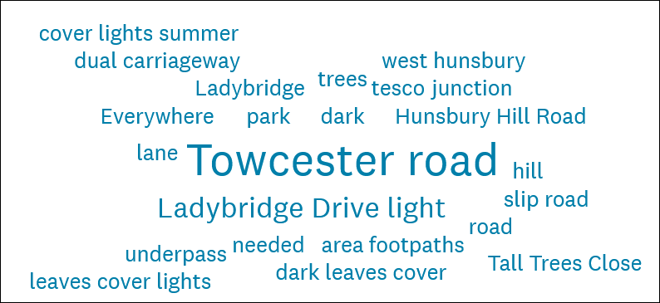
Q9 - Do you think there is adequate street and path lighting in West Hunsbury ?
Generally positive
Most comments about Towcester Road from Ladybridge Drive to Mereway Roundabout
Also the turning from Danes Camp Way into Ladybridge Drive
Trees blocking lights were mentioned many times.
Footpath lighting in parks also got quite a few mentions

Slide 12
Q10 What do you think of the services delivered by West Northants Council?

Slide 13
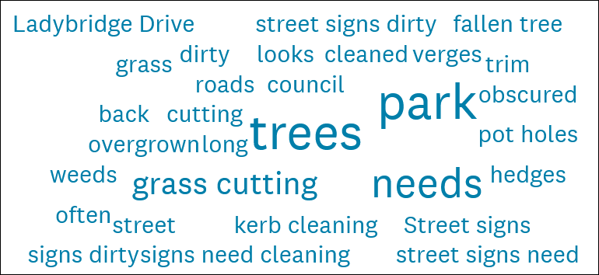
Q10 What do you think of the services delivered by West Northants Council?
Generally positive
Refuse collections stand out as being very good
Kerb cleaning perhaps the worst
Significant number of comments about trees and tree maintenance, especially in the brook
A large number of comments about dirty or poor road signs
Brown bin charges got a few mentions
Lots of comments on pot holes

Slide 14
Q11 - Have you heard of or used Street Doctor or FixMyStreet
High proportion of respondents had not heard of the issue reporting processes
Some had heard but never used.
Those that had used them there was a real split between very good and quick to poor and slow
Pot holes were slow to fix but other issues seem to have been resolved well and quickly

Slide 15
Q12 - Do you think the Police coverage of West Hunsbury to be….?
Comments written elsewhere in the survey mentioned lack visibility of the police
Where they had been called responses were generally good

Slide 16
Q13 – Are you concerned with any of the following in West Hunsbury ?

Slide 17
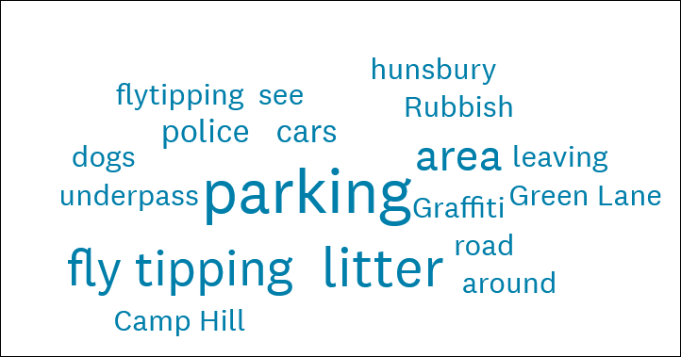
Q13 – Are you concerned with any of the following in West Hunsbury ?
Fly tipping appears to be a concern
Graffiti in underpasses got a number of mentions
Parking – mainly parking on verges & outside houses
BBQ’s in Hunsbury parks
‘boy racers’ at night driving through the area
Some mention of drug dealing
A few on general littering
Not many comments on Anti-Social Behaviour (ASB)

Slide 18
Q14 - Do you or your family use the local parks in West Hunsbury ?
High proportion of respondents use the parks
Most comments were ‘Regularly used’
‘Other’ included mainly Upton, a piece of land behind Banbury Close and the Canal/Hunsbury Meadows
Less than 6% never used the parks

Slide 19
Q15 - What do you use the parks for?
‘Other’ was mainly walking
There were a number that mentioned mental health reasons, relaxation
Connecting with nature e.g feeding the ducks
Family time also came up

Slide 20
Q16 & 17 - Do you use the Community Centres?
High proportion of respondents never use the Community Centres
Most comments were ‘not aware of what's on’
WI, Beavers and Cubs, Tots group, Scouts, keep fit, dance group, U3a, quiz night
60+, FoWHP, WI sub groups, WHPC, fitness and bingo, social activities

Slide 21
Q18 - Do you think the Community Centres meet the needs of Residents?
Comments:
Not aware of what's on
No advertising
Don’t know how to book
Didn’t know they existed
Need more events
Don’t know anything about them
More information on groups that meet there
Nice to meet up with people
More community events needed there

Slide 22
Q19 - Do you feel the following issues are being addressed adequately within West Hunsbury Parish?

Slide 23
Q19 - Do you feel the following issues are being addressed adequately within West Hunsbury Parish?
Only answered by 78% of the respondents
The three highest scoring appear to reflect the green spaces we have within the Parish
A significantly high percentage with no opinion
The comments are interesting to read and reflect a wide view within the community, they need to be studied further and in more depth
Comments range from: ‘I think the Parish Council could work with partners to take a stronger role in each of these areas better representing residents and the valued assets within the parish (trees, open spaces, parks etc)’ to ‘Don’t know enough, should Parish Council be involved in these issues?’

Slide 24
Q20 - Which community events in the Parish have you attended in the last two years?
‘Other’ were events outside of the Parish
42.7% had not attended an event
32.8% attended the fireworks
28.3% the Jubilee

Slide 25
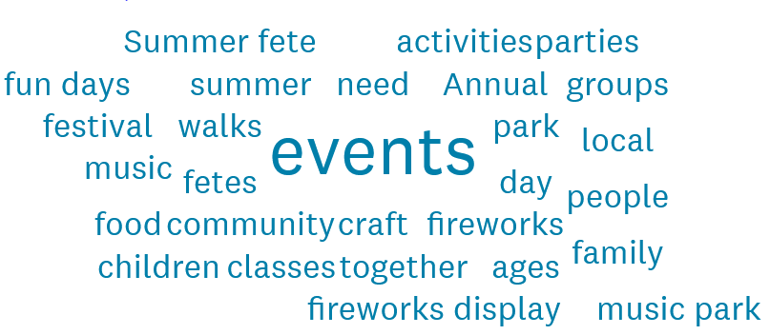
Q21 - Are there any community events you would like to see within the Parish?
127 responses, Comments:
Annual fireworks
Family events / fun days for children
Community fun days/Community groups
Craft fayres
Music events/music in the park
Summer fair
Barn Dance – Nacre barns
Community litter pick
Events in or around Hunsbury Hill Fort
Diwali event
Carol service

Slide 26
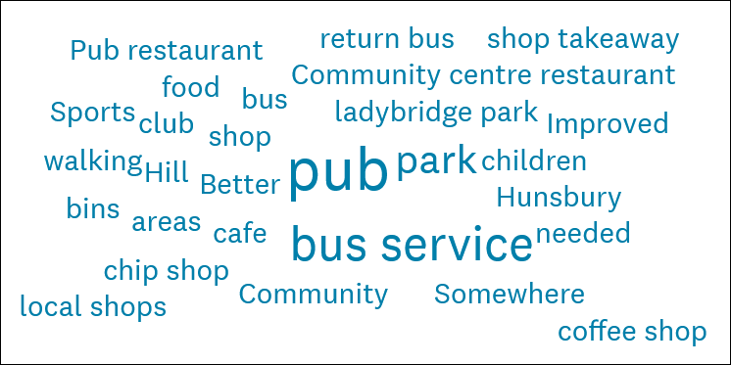
Q22 -Are there any other facilities that you would like to see?
Others
Improved parking at shops
Allotment/community veg plot
Football changing area
More benches in the parks
Youth club
Wildflower gardens
Food bank
Top 5
Pub
Bus Service
Take away food / Café (esp Ladybridge Park)
Improved Childrens play facilities
Longer opening hours for the shop

Slide 27
Q23 - Do you ever use any of the following to see what is going on in the Parish or to contact West Hunsbury Parish Council?
Noticeboards are the most popular form of communication
Facebook is significantly higher than the website
Poor response for Councillor surgeries

Slide 28
Q24 - Do you feel there is a sense of community and well being within the Parish?
Comments
More and better information needed on events / activities
Good supportive dog community
Good community on our street, friendly neighbours
Don’t feel the Parish council work to create a community feel and bringing the groups in the area together
East Hunsbury is stronger, needs building, poor relations to East Hunsbury
At the moment the parish council is not joined to the community
High proportion of rented accommodation/HMO’s
Nice gathering in St Benedicts church
Everyone keeps themselves to themselves
Over 50% feel there is a sense of community/well being
Comments are interesting and require further investigation

Slide 29
Q25 - Is there is anything else you would like to say about West Hunsbury that you think would be useful for the purpose of this community survey?
Better Bus service
litter bins in the parks need replacing
Blocking of brook with falling trees
E-scooters are an eyesore
The large area parks and green spaces of West Hunsbury is the main feature that make this Parish a good place to live
Church events are nice
Beautiful area
I am just so fed up with how untidy the area has become due to lack of maintenance
Great place to live with good people
develop a cycle plan throughout East and West Hunsbury
EHPC are far more active
more local police patrols, less graffiti, littering
Bird / bat boxes
Better care of hedgerows needed
I would like to see areas of the park left as wildflower meadows.
Parish Newsletter
lovely place to live
Clear underpasses and tend planters
Pot Holes !
Wootton brook and flooding risks
Green lane needs proper maintenance

